Slide 1
Docker Architecture
25-Sep-23
AVIN Systems Private Limited
AVIN Systems Private Limited - Confidential

Slide 2
Contents
Docker Architecture
Conclusion

Slide 3
Docker Architecture
Docker uses a client-server architecture.
The Docker client talks to the Docker daemon, which does the heavy lifting of building, running, and distributing your Docker containers.
The Docker client and daemon can run on the same system, or you can connect a Docker client to a remote Docker daemon.
The Docker client and daemon communicate using a REST API, over UNIX sockets or a network interface. Another Docker client is Docker Compose, that lets you work with applications consisting of a set of containers.

Slide 4
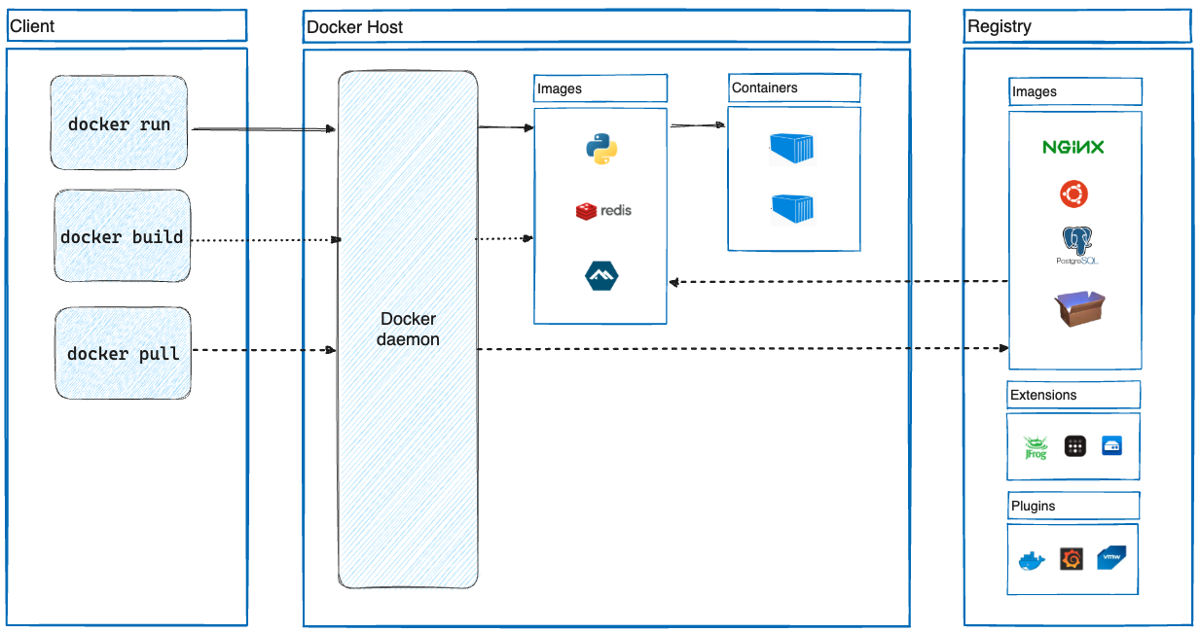
Docker Architecture

Slide 5
Docker Deamon
The Docker daemon, often referred to as `dockerd` , is a core component of the Docker architecture. It is a background service that runs on a host system and is responsible for managing Docker containers.

Slide 6
Key aspects of the Docker Daemon
Container Management: The Docker daemon is responsible for creating, running, stopping, and managing containers. It listens for commands and requests from the Docker client, which is typically accessed via the Docker Command-Line Interface (CLI) or other Docker client tools. When you issue a command to create a container, such as `docker run`, the Docker client communicates with the Docker daemon to carry out the requested action.
API Server: The Docker daemon exposes a REST API that allows clients to interact with it. The Docker client communicates with the daemon over this API, sending commands and receiving responses. This API provides a standardized way to manage containers and images, and it can be accessed locally or remotely, depending on your configuration.

Slide 7
Key aspects of the Docker Daemon
Image Management: Docker images, which are read-only templates for containers, are stored and managed by the Docker daemon. Images can be pulled from Docker registries, stored locally, and used to create containers. The Docker daemon handles image downloads, caching, and storage.
Resource Management: The Docker daemon is responsible for allocating system resources (such as CPU, memory, and disk space) to containers. It ensures that containers run in isolated environments and enforces resource limits and constraints that you specify when creating containers.
Networking: Docker provides networking capabilities for containers, and the Docker daemon manages container networking on the host. It sets up network bridges, overlay networks, and user-defined networks to facilitate communication between containers, between containers and the host, and between containers and external services.

Slide 8
What is Instances In Cloud Computing?
In the context of cloud computing, an "instance" refers to a virtual server(VM) that you can deploy and run in a cloud environment.
Instances provide a flexible and scalable way to deploy and manage your computing workloads in the cloud.
They are essentially virtualized compute resources (CPU, Storage…) and fundamental building block of cloud infrastructure and are used for a wide range of applications, from hosting websites and web applications to running data analytics, machine learning, and more.
Instances are a fundamental concept in cloud computing and are a key component of Infrastructure as a Service (IaaS) offerings like Amazon EC2 (Elastic Compute Cloud) in AWS, Azure Virtual Machines in Microsoft Azure, and Google Compute Engine in Google Cloud.

Slide 9
Some key Characteristics and Concepts elated to Instances
Virtualization: Instances are virtual machines (VMs) that run on physical servers in data centers. Multiple instances can run on a single physical server, and virtualization technology allows for the isolation and efficient utilization of resources.
Resource Configuration: When you create an instance, you can specify its resource configuration, including the amount of CPU (vCPUs), memory (RAM), storage (disk space), and other resources. The specific configurations available depend on the cloud provider and the instance types offered.
Operating System: Instances typically run an operating system (OS) of your choice. You can choose from a variety of OS options, including Linux distributions (e.g., Ubuntu, CentOS) and Windows Server editions.

Slide 10
Some key Characteristics and Concepts elated to Instances
Networking: Instances have their own network interfaces and IP addresses. You can configure networking settings, including security groups, firewalls, and routing, to control network access to and from your instances.
Scalability: Cloud providers offer the ability to scale instances up or down based on your needs. You can increase resources during periods of high demand and reduce resources during periods of lower demand.
Elasticity: Instances can be part of auto-scaling groups that automatically adjust the number of instances based on traffic or resource utilization. This helps ensure that your applications are responsive and cost-efficient.
Lifecycle: Instances have a lifecycle that includes creation, running, stopping, starting, and termination. Termination permanently removes the instance and associated resources.

Slide 11
Some key Characteristics and Concepts elated to Instances
Storage: Instances may have associated storage options, including local instance store (ephemeral storage) and block storage (e.g., Amazon EBS in AWS, Azure Disk in Azure). The choice of storage affects data durability and persistence.
Images: To create an instance, you often start with an image (also known as an Amazon Machine Image, AMI, in AWS). An image is a template that defines the initial configuration and software setup for the instance.
Access Control: You can control access to instances using key pairs (for SSH access) or username/password combinations. Security groups and network ACLs allow you to define network-level access controls.

Slide 12
Conclusion
Cloud computing has transformed the way organizations and individuals use and manage IT resources.
It offers scalability, flexibility, cost efficiency, and the ability to focus on core business functions while leaving infrastructure management to cloud providers.
As a result, cloud computing has become an integral part of modern technology ecosystems across various industries.

Slide 13
Thank You

